Slide 1
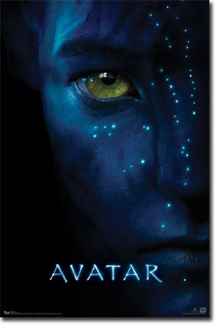
Overview of AVATAR
Presented by, ABINAYA
PRIYANKA SHANKAR
RAJALAKSHMI
VENNILA GLORY ALFONCE

Slide 2
Plot
alien world of Pandora
Na'vi people
human/Na'vi hybrids, called Avatars, must link to human minds to allow for free movement on Pandora.
a paralyzed former Marine
a Na'vi woman
As a bond with her grows, he is drawn into a battle for the survival of her world.

Slide 3
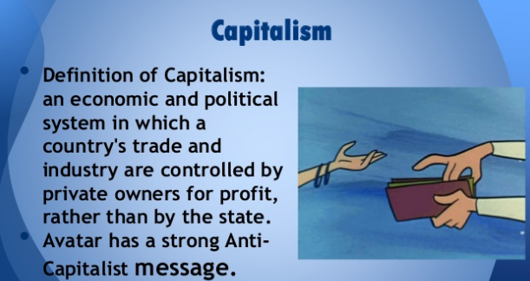
Further the film portrays capitalism in a unique way
Na'vi people(Anti-Capitalist)
Humans(Capitalist)

Slide 4
Cameron’s wonder
Avatar's key concepts were conceived much earlier, as far back as the Sixties, when Cameron was a daydreaming nerd in high school.
Behind the cameras, Cameron furthermore pioneered his own "Reality Camera System", two high-definition lenses operated side by side to conjure an uncanny sense of depth and realism.
But after millions of dollars of research and development, the Avatar's face was not only lifeless, it was downright creepy.

Slide 5
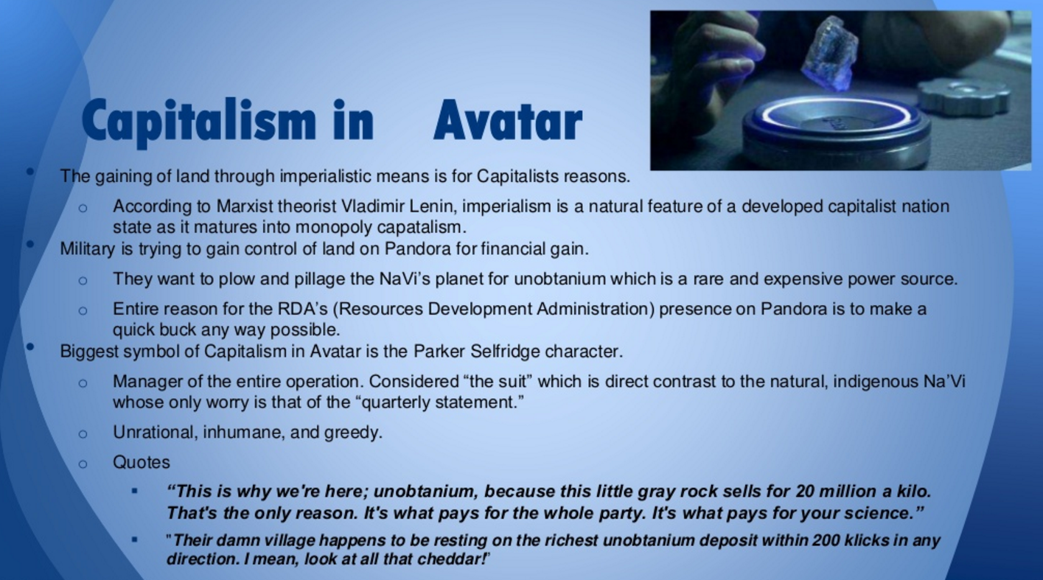

Slide 6
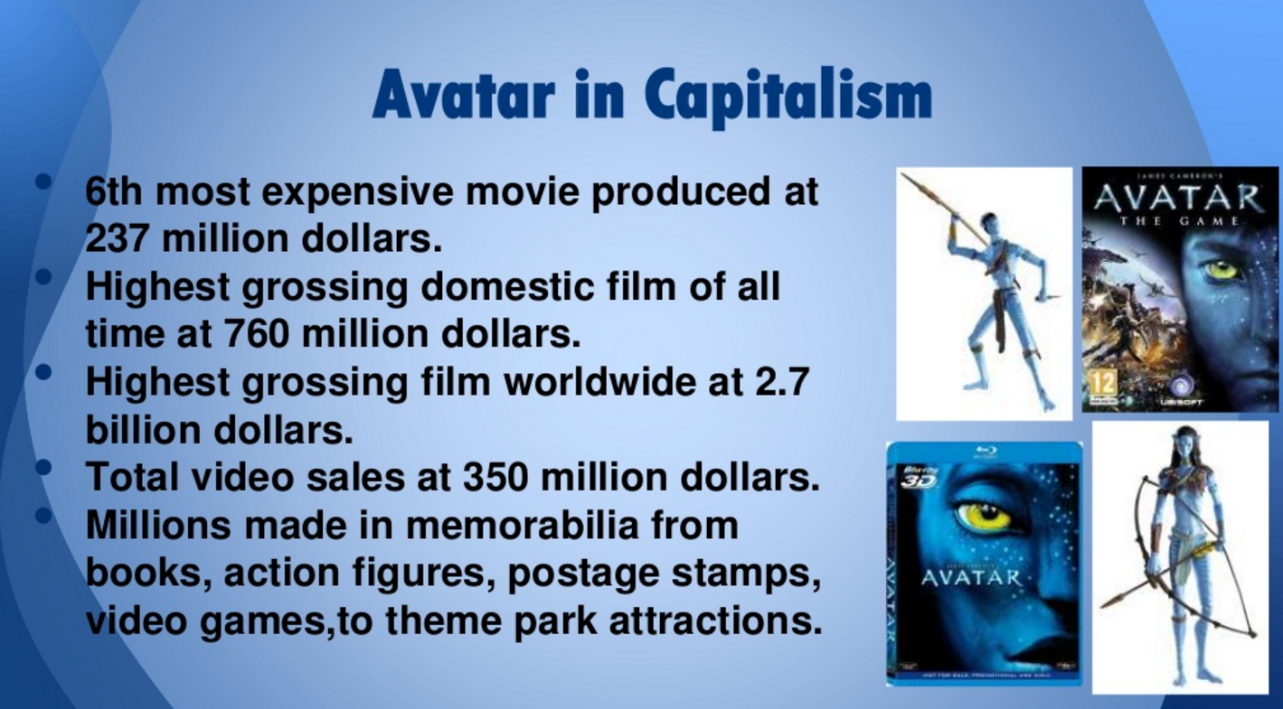
Real time capitalism

Slide 7
Technology
AVATAR was roughly 60 percent computer generated (CGI), filmed with motion capture technology using live actors.
The rest of the film was actual live-action, generously laden with director James Cameron's trademark visual special effects. The live-action parts were filmed in New Zealand

Slide 8
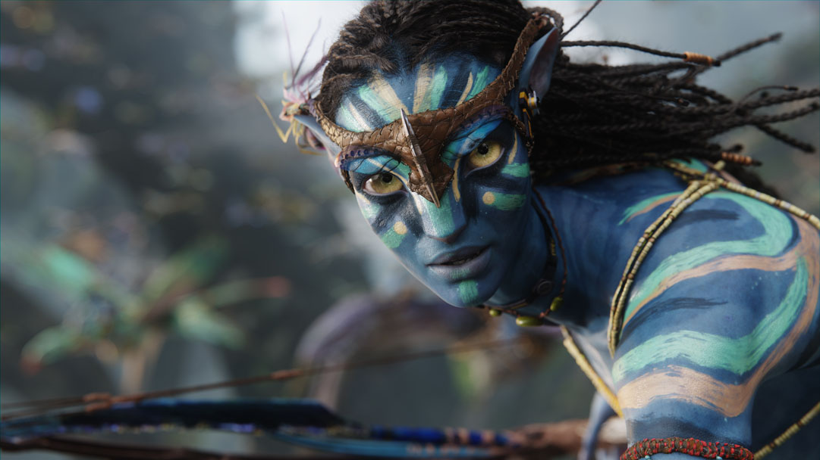
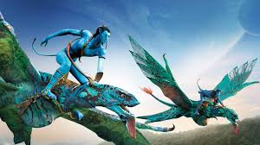


Slide 9
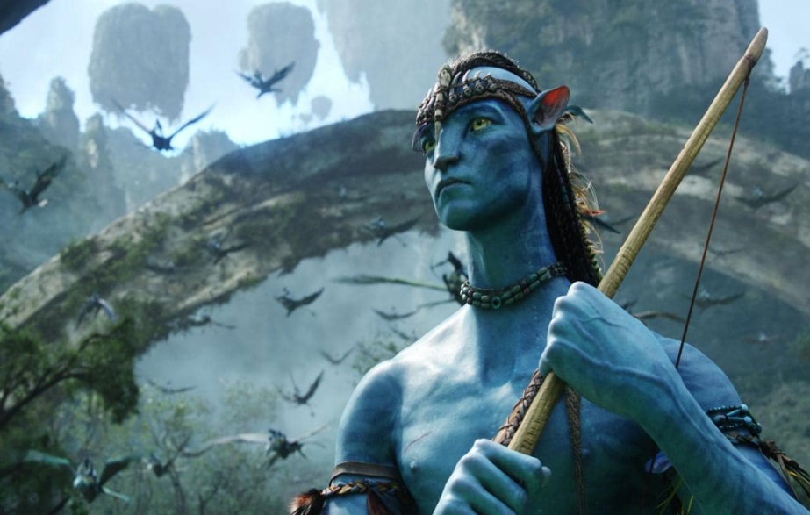

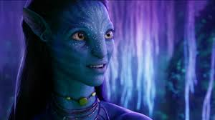


Slide 10


Slide 11


Slide 12
Expected expenses
Creating a new language and teaching it to a 100 actors/actresses
Creating cutting edge 3D CGI graphics unlike any ever seen
Hiring 20 name brand actors
3D glasses in 20K theaters nationwide
Paying the script writers for writing such an awesome script that would sell
Paying the director

Slide 13
Expected expenses
Creating a new language and teaching it to a 100 actors/actresses 500K
Creating cutting edge 3D CGI graphics unlike any ever seen 150M
Hiring 20 name brand actors 100M
3D glasses in 20K theaters nationwide 20million
Paying the script writers for writing such an awesome script that would sell 9.5M
Paying the director 20million

Slide 14
Pre-production estimation
Estimates put the cost of the film at about $280–310 million
to produce and an estimated $150 million for marketing
$30 million in tax credits
Total budget was "$237 million

Slide 15
Post production expenses
$150 million for promotion of the movie.
First Day Collection
$26,752,099 on its opening day
$77,025,481 over its opening weekend
Revenues in the film's second weekend decreased by only 1.8% in domestic markets

Slide 16
“Avatar” Benchmark
Avatar crossed the $1 billion mark on the 19th day of its international release, making it the first film to reach this mark in only 19 days.
fifth-weekend record with a take of $42,785,612
fastest film to gross $600 million domestically, on its 47th day
January 31, it became the first film to earn over $2 billion worldwide

Slide 17
Avatar had sold approximately 75 million tickets in North America
Budget | $237 million $9 million+ (re-release)
Box office | $2.788 billion

Slide 18
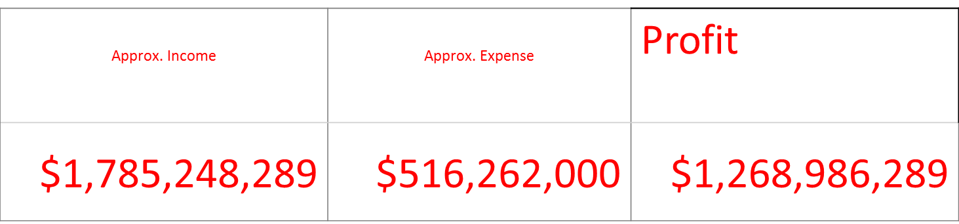
Production Budget | Domestic Gross | Worldwide Gross
$425,000,000 | $760,507,625 | $2,783,918,982

Slide 19
Capital
There was a clash between Disney and 20th Century Fox regarding its ownership , finally Fox accepted Avatar
Production companies included:
20th Century Fox
Lightstorm Entertainment
RatPac-Dune Entertainment
Ingenious Media

